Slide 1
While watching the video clip below, write down the varying types of landscapes you see. When instructed share these with a partner.
This is Australia: Great Southern Land
In this lesson you will learn how location, climate, and natural resources impact the people of Australia.

Slide 2
How do location, climate, and natural resources affect people in Australia?
Standard(s):
SS6G13a. Describe how Australia’s location, climate, and natural resources have affected where people live.
SS6G13b. Describe how Australia’s location, climate, and natural resources impact trade.

Slide 3
Examine the population density, natural resources, climate and physical features of Australia.
Use the maps to answer questions about Australia.

Slide 4
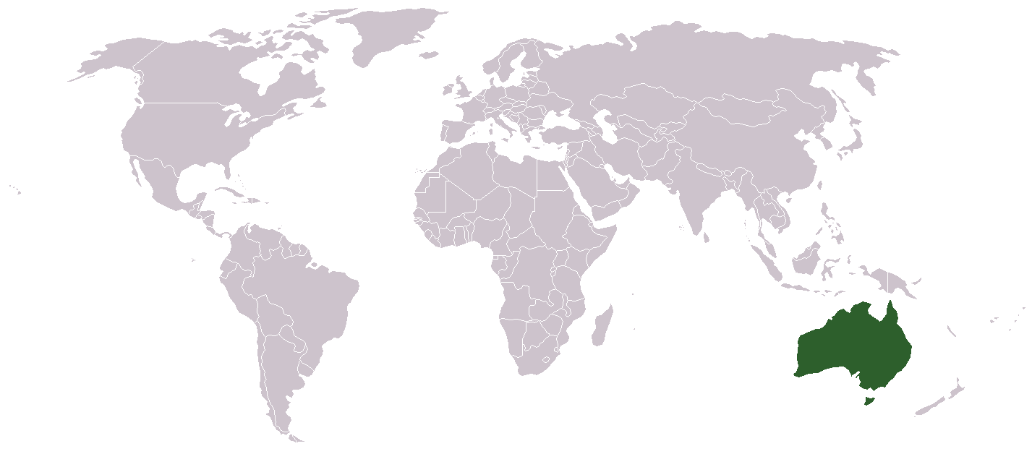
Australia

Slide 5
Use your graphic organizer to summarize the important information from the lesson.

Slide 6
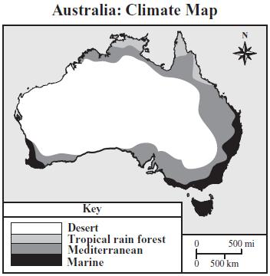
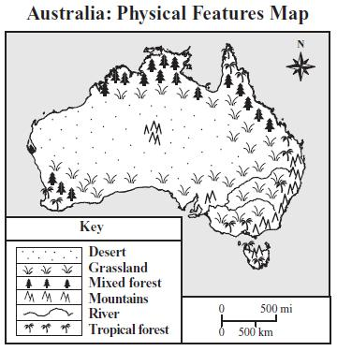
Australia’s Land & Climate

Slide 7
Australia’s Land & Climate
Deserts cover two-thirds of the island
The interior of the island is mostly dry, flat land called the outback
The most fertile land on the island is near the coast, which has access to plenty of rain and fresh water

Slide 8
Australia’s Land & Climate
Summer lasts from Dec-Mar and Winter lasts from June-August
Coastal areas get plenty of rain in the summer and winter while the interior stays dry all year
On the coast temperatures are usually mild while the interior (outback) stays warm during the day and chilly at night

Slide 9
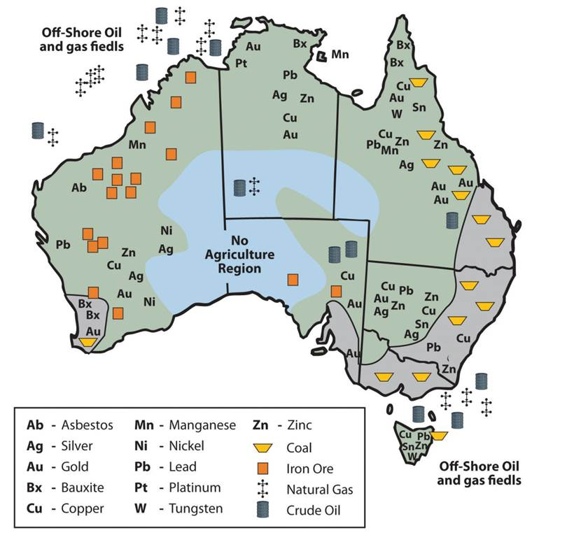
Australia’s Natural Resources

Slide 10
Australia’s Natural Resources
The coastline has many natural resources
One of Australia’s largest natural resources is coal, which is burned for energy. Iron ore and gold are other important natural resources
It produces enough coal to provide electricity for its citizens and sells the rest to other countries
In the outback, there are huge ranches. Many farmers raise sheep that produce wool to export

Slide 11
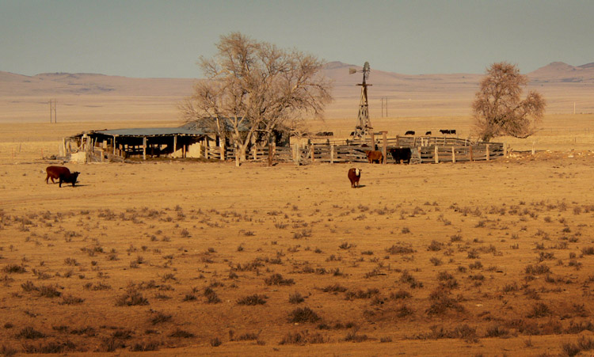
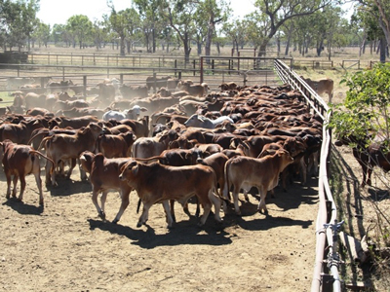
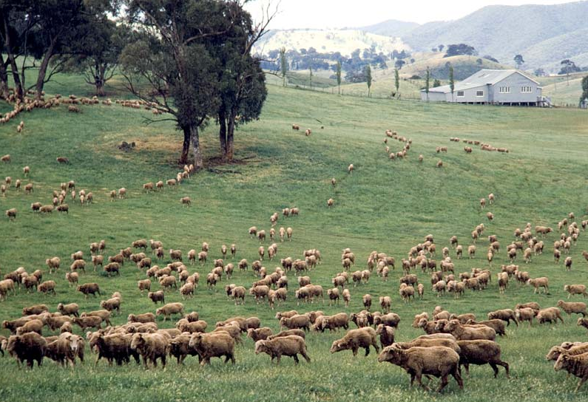
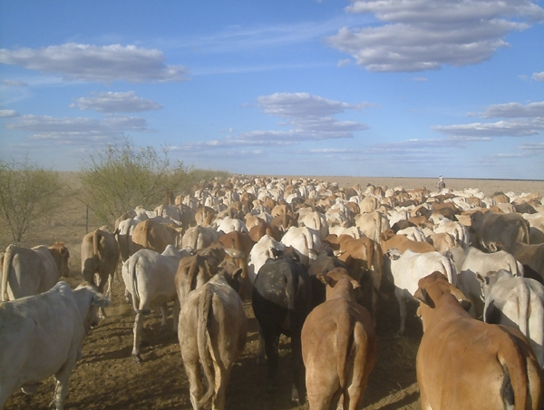

Slide 12
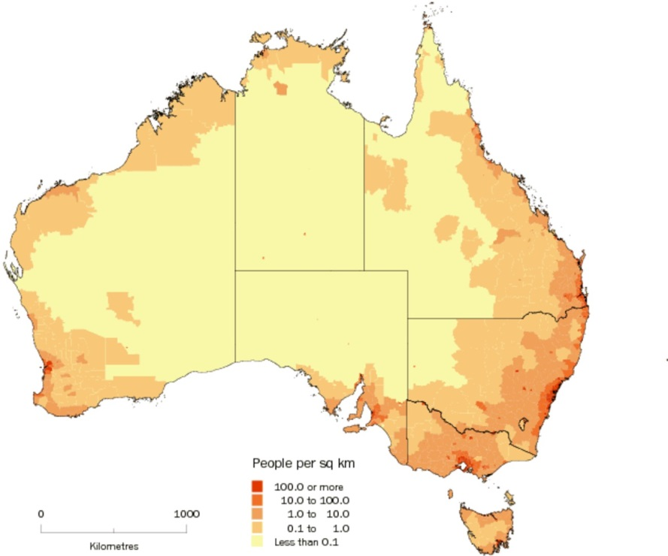
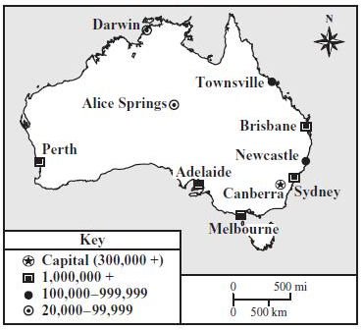
Where do most people live in Australia? Why?

Slide 13
Most Australians live along the Eastern and Southeastern coastline because of its fresh water, fertile land, and natural resources.

Slide 14
Many Australians live in large coastal towns where they have access to large industries and international businesses.

Slide 15
Write a sentence using location, climate, or natural resources that could convince someone to visit Australia. When instructed, share your sentence with a partner.

Slide 16
How does Australia’s location impact its trade?

Slide 17
Who are Australia’s main trading partners? Why?
Export Partners: China 33.7%, Japan 18%, South Korea 7.4%, US 4.2% (2014 CIA World Factbook)
Import Partners: China 20.5%, US 10.6%, Japan 6.8%, Singapore 5%, Germany 4.7%, South Korea 4.7% (2014 World Factbook)

Slide 18
Because of Australia’s location in the southeast Pacific Ocean, its main trading partners are China, Japan, South Korea, and other Asian countries.

Slide 19
The summarizer gives you four scenarios and asks you identify on a map where you would live based on the scenario and then an explanation of why you would live there using details from the lesson.
Let’s do an example together.

Slide 20
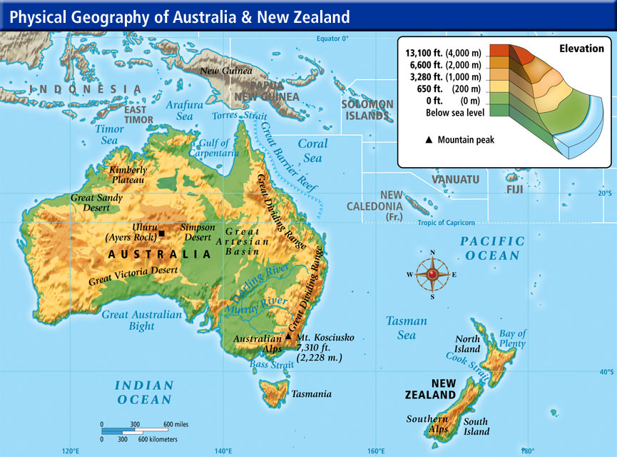
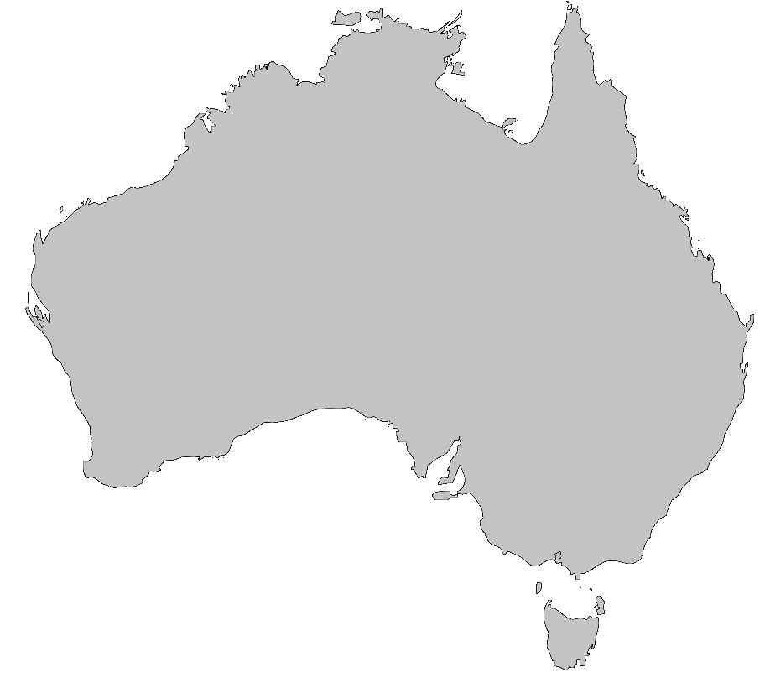
As a tourist visiting Australia, I decide to visit Mt. Kosciusko and the Murray River (no these are not physical features that you previously learned).
First, I identify these physical features on my Australia blank map. Second, I write 2-3 sentences describing where I’m visiting and the types of things I experience based on the information I received from the lesson.
Murray River
Mt. Kosciusko
Based on what you learned, what might we include in our sentence(s)?
Today I visited Mt. Kosciusko in southeastern Australia while the temperatures were mild. Tomorrow I plan to visit the mouth of the Murray River which is located near a major city so there will be a lot of people to see. It will be sunny with a mild temperature which should make walking around more pleasant.

